Slide 1

MCO- 1 ITE-5
Student Information System (SIS) Database Optimization
Rosales, Melchor
Dacles, Kristel Joy
labong, Jayboy

Slide 2
OBJECTIVES:
The core purpose of this project is to evaluate and optimize the existing relational database structure (schema) for a Student Information System (SIS). This includes a detailed analysis of the schema's design, focusing on critical factors such as quality, reliability, scalability, efficiency, effectiveness, and security. We will identify and correct structural issues, including data redundancy and normalization problems. The final result will be a complete redesign that produces an optimized database schema a robust, improved structure that guarantees better data integrity and high performance for all operations within the SIS.

Slide 3
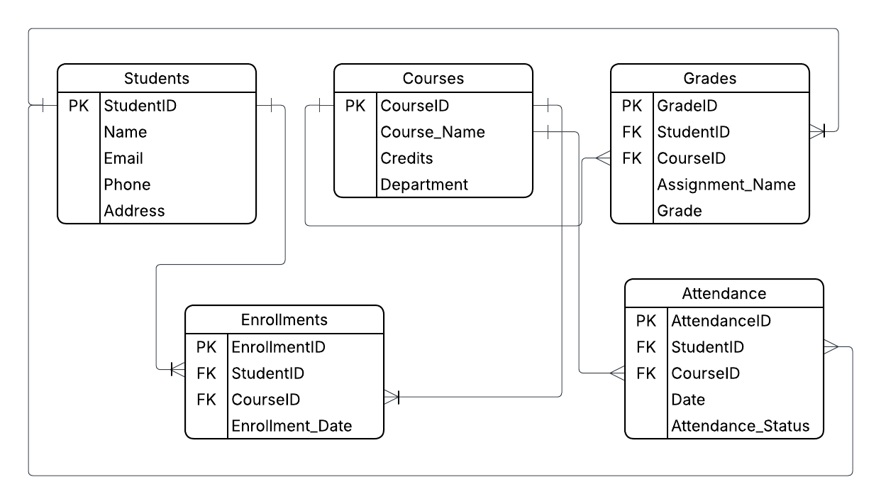
ORIGINAL ERD

Slide 4
THE PROBLEM
1. The "Clutter" Flaw (1NF Violation)
  Issue: Student addresses were stored as one long string (Street, City, and Zip combined).
  Impact: You cannot search or filter students by city or street because the data is "cluttered" together.
2. The "Double Entry" Flaw (Redundancy)
  Issue: Student and Course IDs were repeated in Enrollments, Grades, and Attendance.
  Impact: Storing the same link in three places makes the data harder to update and increases the risk of "ghost" grades for students who aren't even enrolled.
3. The "Rounding" Flaw (Data Integrity)
  Issue: Grades were set as whole numbers (INT), but actual grades use decimals (like 85.50).
  Impact: The database would force-round grades, leading to inaccurate student records and unfair GPA calculations.
4. The "Consistency" Flaw (Missing Guardrails)
  Issue: Attendance and Name fields were "open text" with no restrictions or "NOT NULL" rules.
  Impact: Users could leave names blank or type different words for the same status (like "P" vs. "Present"), making it impossible to generate accurate reports.

Slide 5
THE SOLUTIONS
Step 1: Making Data Atomic (1NF)
  The Fix: We broke down "cluttered" information into individual parts.
  Example: Instead of one big address block, we separated it into Street, City, and Zip Code so the system can finally filter students by location.
Step 2: Fixing the "Double Entry" (2NF)
  The Fix: We removed "Partial Dependencies."
  Example: In the old system, Grades and Attendance were linked to both Student and Course IDs separately. We optimized this by linking them only to a single Enrollment_ID, ensuring a grade cannot exist without a valid enrollment.
Step 3: Removing Indirect Connections (3NF)
  The Fix: We eliminated "Transitive Dependencies."
  Example: We noticed the Courses table was also trying to manage Department names. We created a dedicated Departments table so that changing a department name happens in one place, not in every single course record.

Slide 6
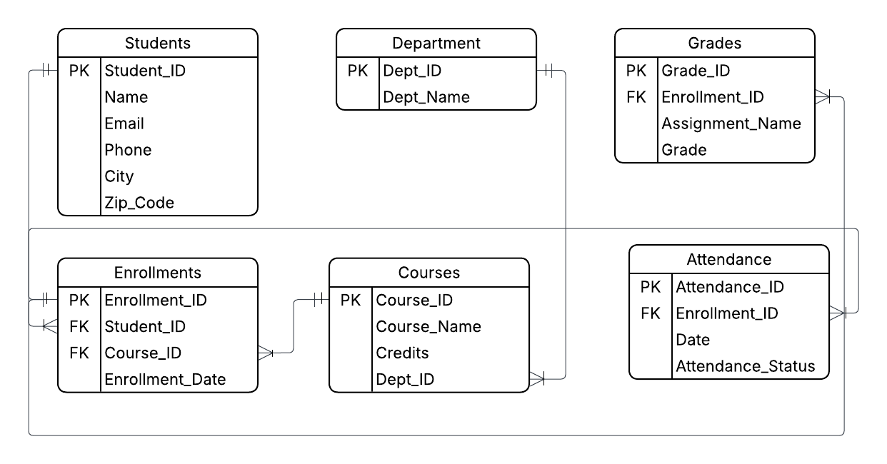
NORMALIZED ERD

Slide 7
Building the Database (Implementation)
  The Build (sis_create.sql): We used MariaDB to create tables with strict "NOT NULL" rules and Primary Keys to prevent junk data.
  The Data (sis_queries.sql): We populated the system with 13 real-world sample records, including diverse names and addresses.
  Result: A clean, relational storage system where every student and course record is unique.

Slide 8
Data Definition Language (DDL)
-- 1. Departments Table (Eliminates Transitive Dependency)
CREATE TABLE Departments (
Dept_ID INT,
Dept_Name VARCHAR(50) NOT NULL UNIQUE,
CONSTRAINT pk_Departments PRIMARY KEY(Dept_ID)
);
-- 2. Students Table (Ensures Atomic Attributes for Names/Addresses)
CREATE TABLE Students (
Student_ID INT,
First_Name VARCHAR(50) NOT NULL,
Last_Name VARCHAR(50) NOT NULL,
Email VARCHAR(100) NOT NULL UNIQUE,
Phone VARCHAR(20),
Street VARCHAR(100),
City VARCHAR(50),
Zip_Code VARCHAR(10),
CONSTRAINT pk_Students PRIMARY KEY(Student_ID)
);

Slide 9
Data Definition Language (DDL)
-- 3. Courses Table (Linked via Dept_ID)
CREATE TABLE Courses (
Course_ID INT,
Course_Name VARCHAR(100) NOT NULL,
Credits INT NOT NULL,
Dept_ID INT,
CONSTRAINT pk_Courses PRIMARY KEY(Course_ID),
CONSTRAINT fk_Departments_Courses FOREIGN KEY(Dept_ID) REFERENCES Departments(Dept_ID)
);
-- 4. Enrollments Table (The Central Hub for M:M Relationships)
CREATE TABLE Enrollments (
Enrollment_ID INT,
Student_ID INT NOT NULL,
Course_ID INT NOT NULL,
Enrollment_Date DATE,
CONSTRAINT pk_Enrollments PRIMARY KEY(Enrollment_ID),
CONSTRAINT fk_Students_Enrollments FOREIGN KEY(Student_ID) REFERENCES Students(Student_ID),
CONSTRAINT fk_Courses_Enrollments FOREIGN KEY(Course_ID) REFERENCES Courses(Course_ID)
);

Slide 10
Data Definition Language (DDL)
-- 5. Grades Table (Redesigned to remove Partial Dependencies)
CREATE TABLE Grades (
Grade_ID INT,
Enrollment_ID INT NOT NULL,
Assignment_Name VARCHAR(50),
Grade DECIMAL(5,2),
CONSTRAINT pk_Grades PRIMARY KEY(Grade_ID),
CONSTRAINT fk_Enrollments_Grades FOREIGN KEY(Enrollment_ID) REFERENCES Enrollments(Enrollment_ID)
);
-- 6. Attendance Table (Linked to Enrollment for consistency)
CREATE TABLE Attendance (
Attendance_ID INT,
Enrollment_ID INT NOT NULL,
Attendance_Date DATE,
Attendance_Status VARCHAR(10) CHECK (Attendance_Status IN ('Present', 'Absent', 'Late')),
CONSTRAINT pk_Attendance PRIMARY KEY(Attendance_ID),
CONSTRAINT fk_Enrollments_Attendance FOREIGN KEY(Enrollment_ID) REFERENCES Enrollments(Enrollment_ID)
);

Slide 11
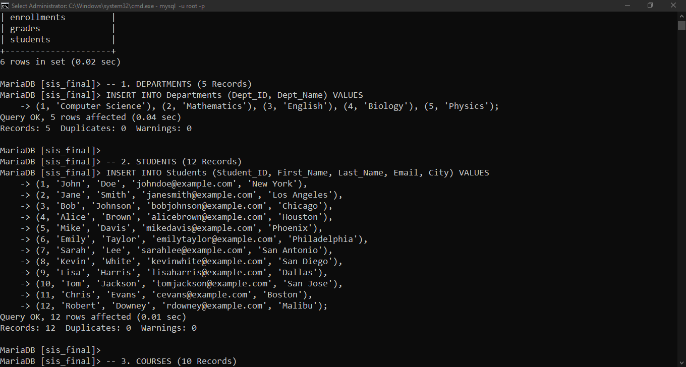
Data Population (DML)

Slide 12
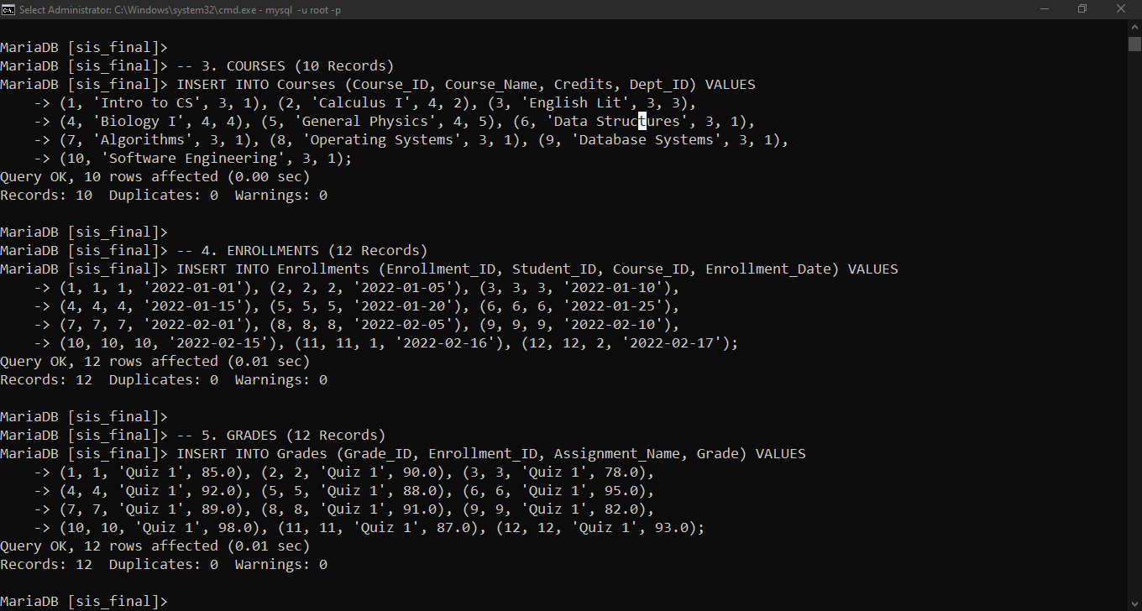
Data Population (DML)

Slide 13
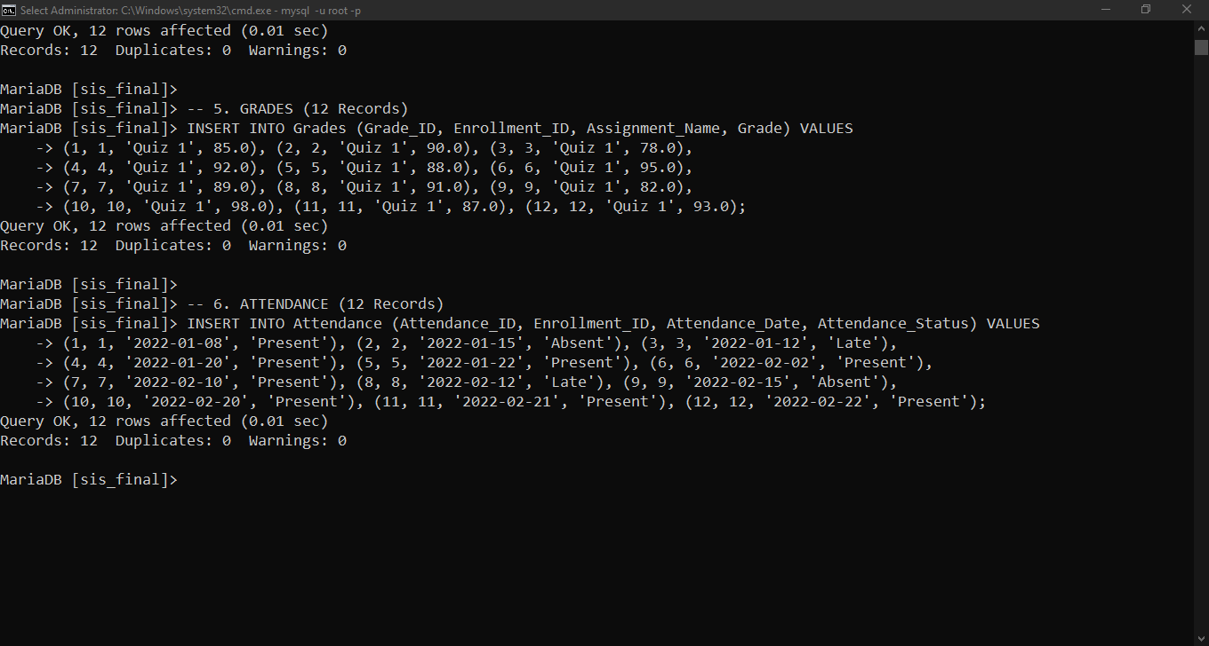
Data Population (DML)

Slide 14
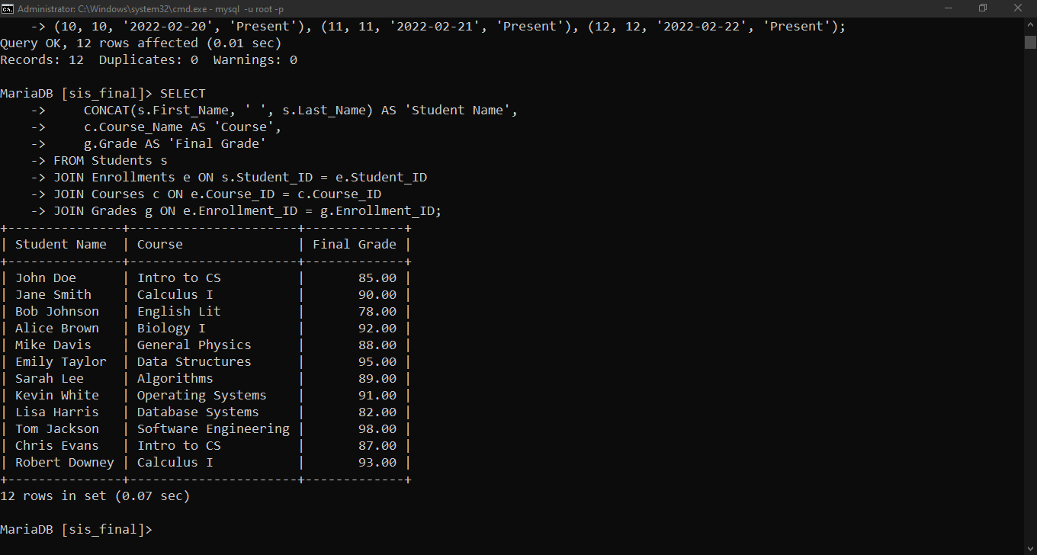
Functional and Performance Testing
Data Retrieval (SELECT with JOINs)

Slide 15
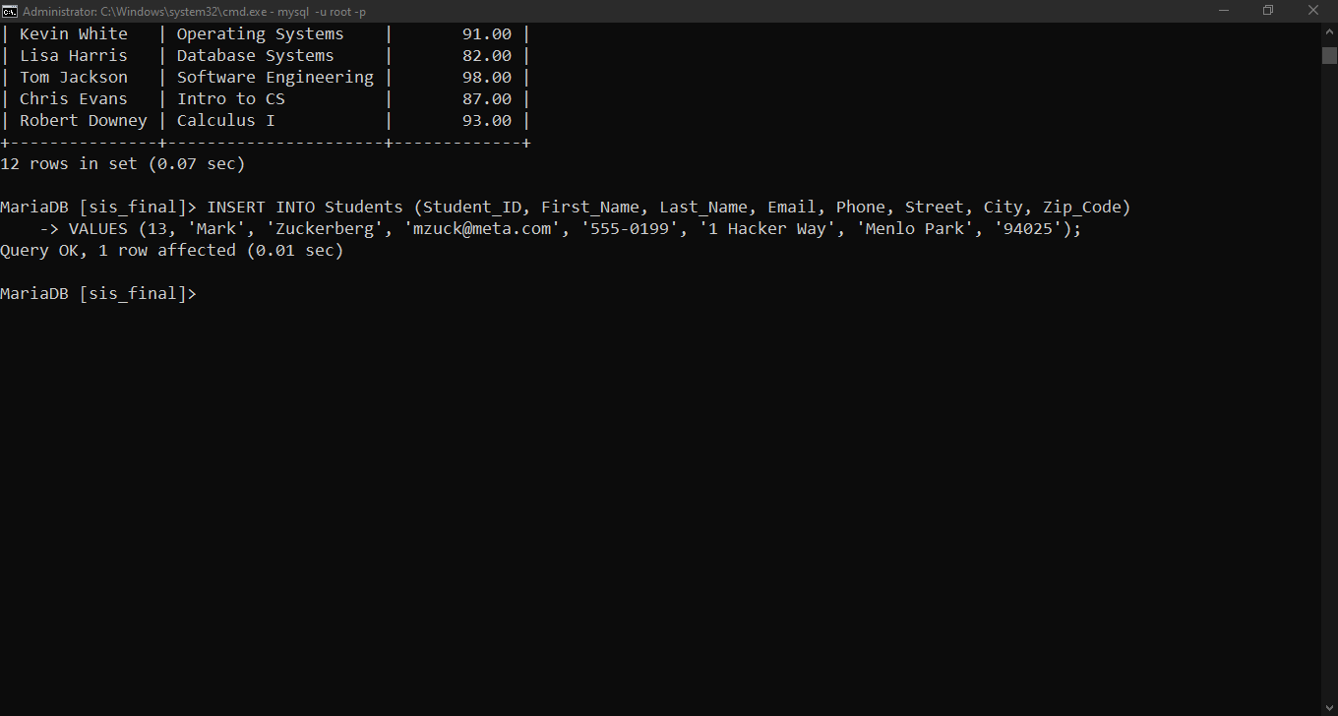
Functional and Performance Testing
Inserting a New Student Record

Slide 16
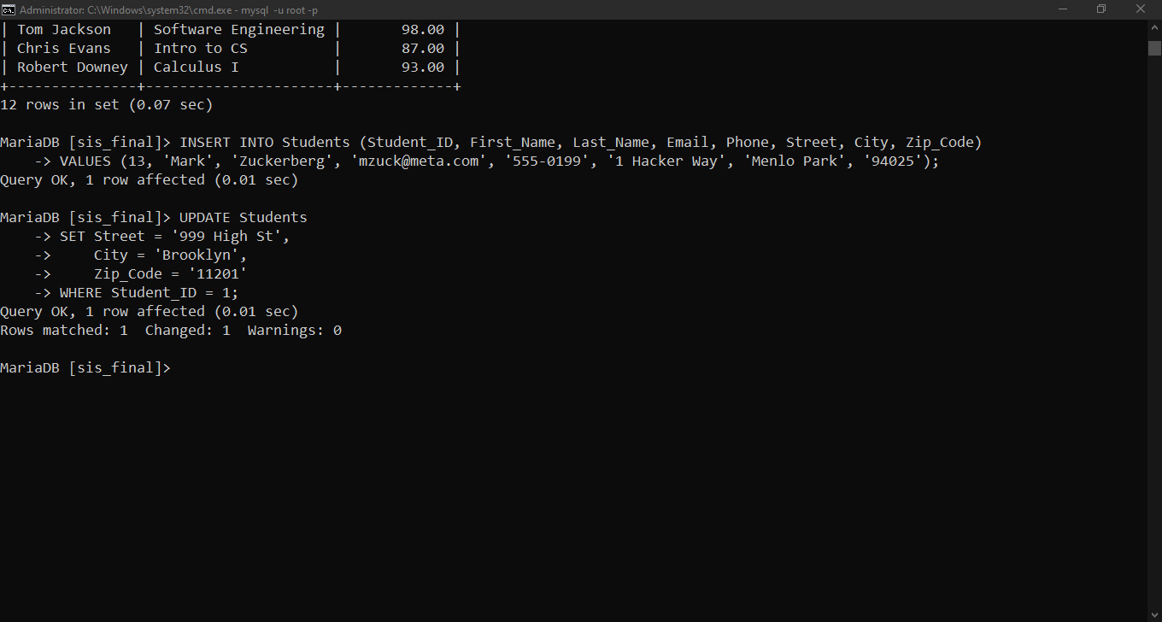
Functional and Performance Testing
Updating an Existing Record

Slide 17
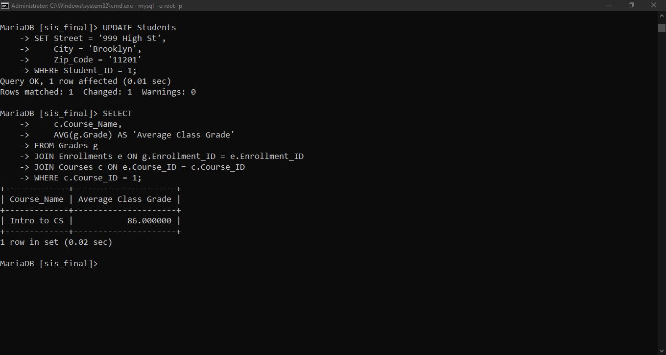
Functional and Performance Testing
Calculating Average Grade for a Course

Slide 18
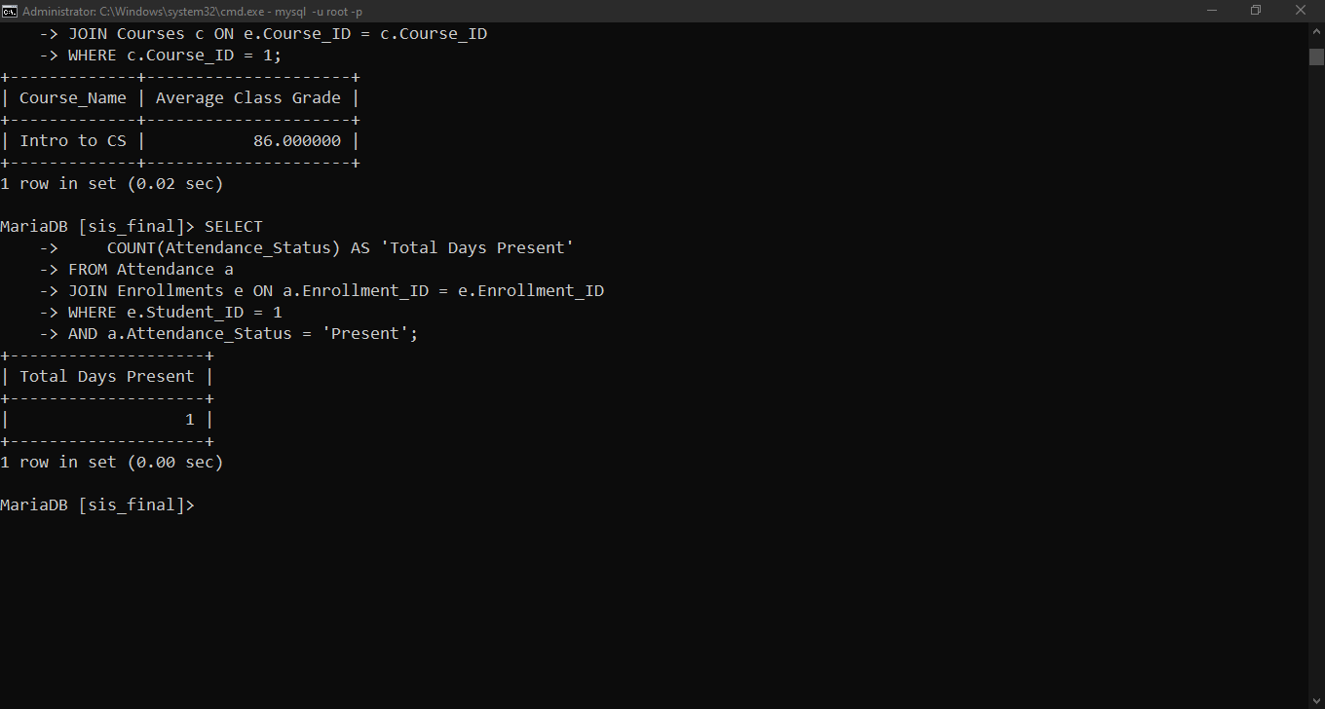
Functional and Performance Testing
Counting Total "Present" Attendance

Slide 19
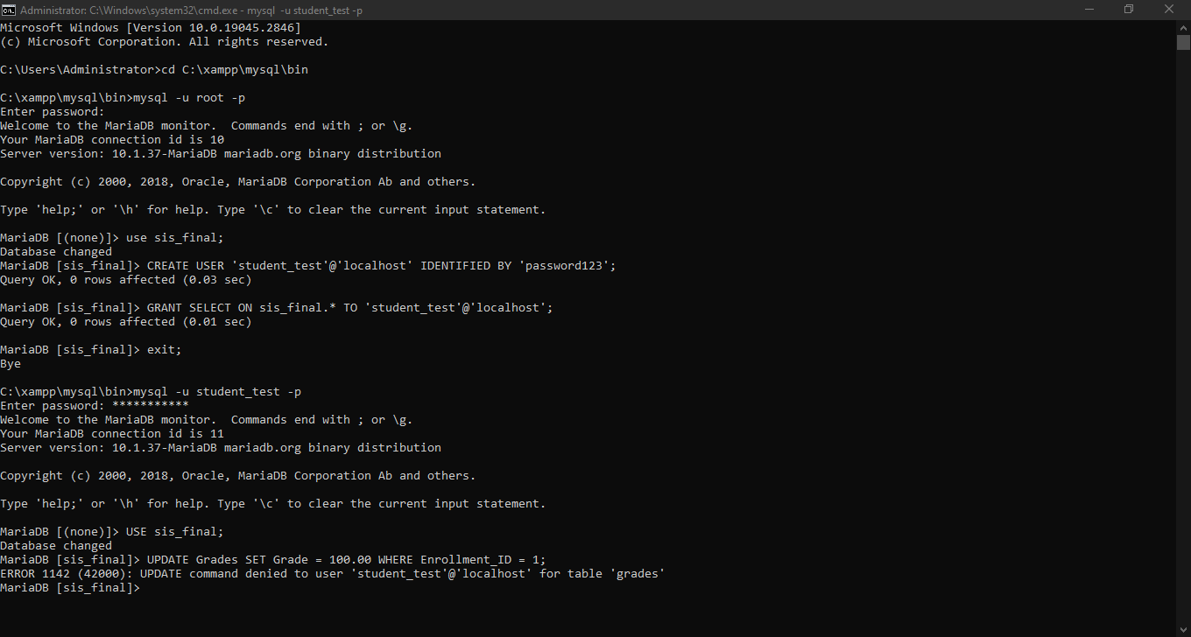
Security Testing
User Access Restrictions

Slide 20
CONCLUSION
Conclusion & Lessons Learned
Project Recap
  3NF Compliant: Our data is now organized into a professional, "lean" structure that eliminates duplicates.
  Storage Efficiency: By removing redundant info, the database uses less memory and runs faster.
  Locked & Secure: Our testing proves that unauthorized grade changes are blocked by the system.
Reflections
  Design First: We learned that spending time on the ERD saves hours of troubleshooting during the coding phase.
  Accuracy Matters: Proper data types (like using decimals for grades) are essential for maintaining a fair academic record.
  Teamwork: Using tools like GitHub allowed us to manage our SQL scripts effectively without losing work.

Slide 21
THANK YOU!!!

